Slide 1
Computer Programming Languages and Python

Slide 2
What is Computer Programming?
It is a way to communicate with a computer to provide instructions on what to do to accomplish a task.
To communicate, you need to provide instructions that computer can understand.
Instructions are provided in a specific language called “Computer Programming Language”.

Slide 3
What is a programming Language?
It is a combination of vocabulary and set of grammatical rules for instructing computers what to do.

Slide 4
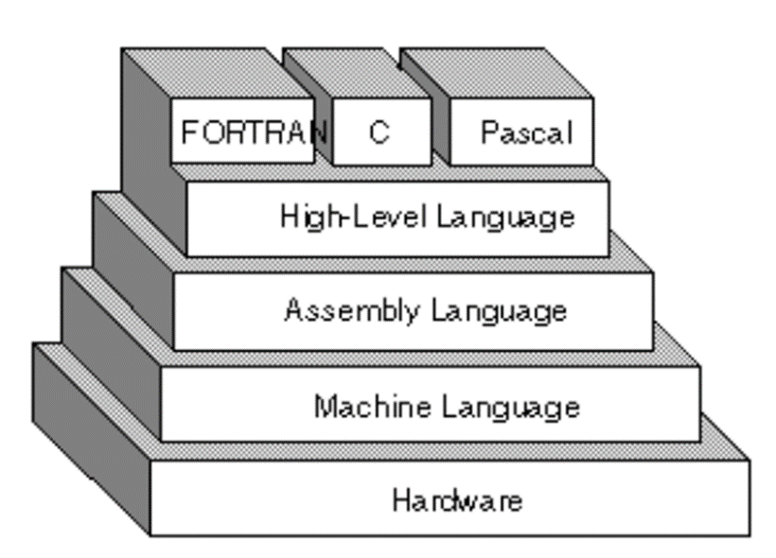
Levels of Programming Languages
webopedia.com

Slide 5
Types of Programming Languages?
Imperative Programming Language: instruct a computer how to do a task
Procedural: Uses sequence of statements to produce a result. Uses many variables and loops to get the result.
Object-oriented: Encapsulation(Everything any object needs must be inside of object)
Declarative Programming Language: instruct a computer what to do
Functional: Program is done by using functions
Logic: Using set of logics.
Scripting: mixture of procedural and OOP but for small programs.
Logic: Program is done using logics (rule based).

Slide 6
Procedural Programming Language
Fortran
ALGOL
COBOL
BASIC
Pascal
C

Slide 7
Object Oriented Programming Language
Java
C++
Python
PHP
Javascript
Ruby

Slide 8
Functional Programming Language
Common LISP
Scheme
Racket
Haskell

Slide 9
Logic Programming Language
LISP
Prolog

Slide 10
Compiler vs Interpreter
Interpreter: Translate high level program into an intermediate form then run in on computer. Takes more time to run for large programs but better for small programs.
Compiler: Translate high level program into machine language program. Faster execution for large programs.

Slide 11
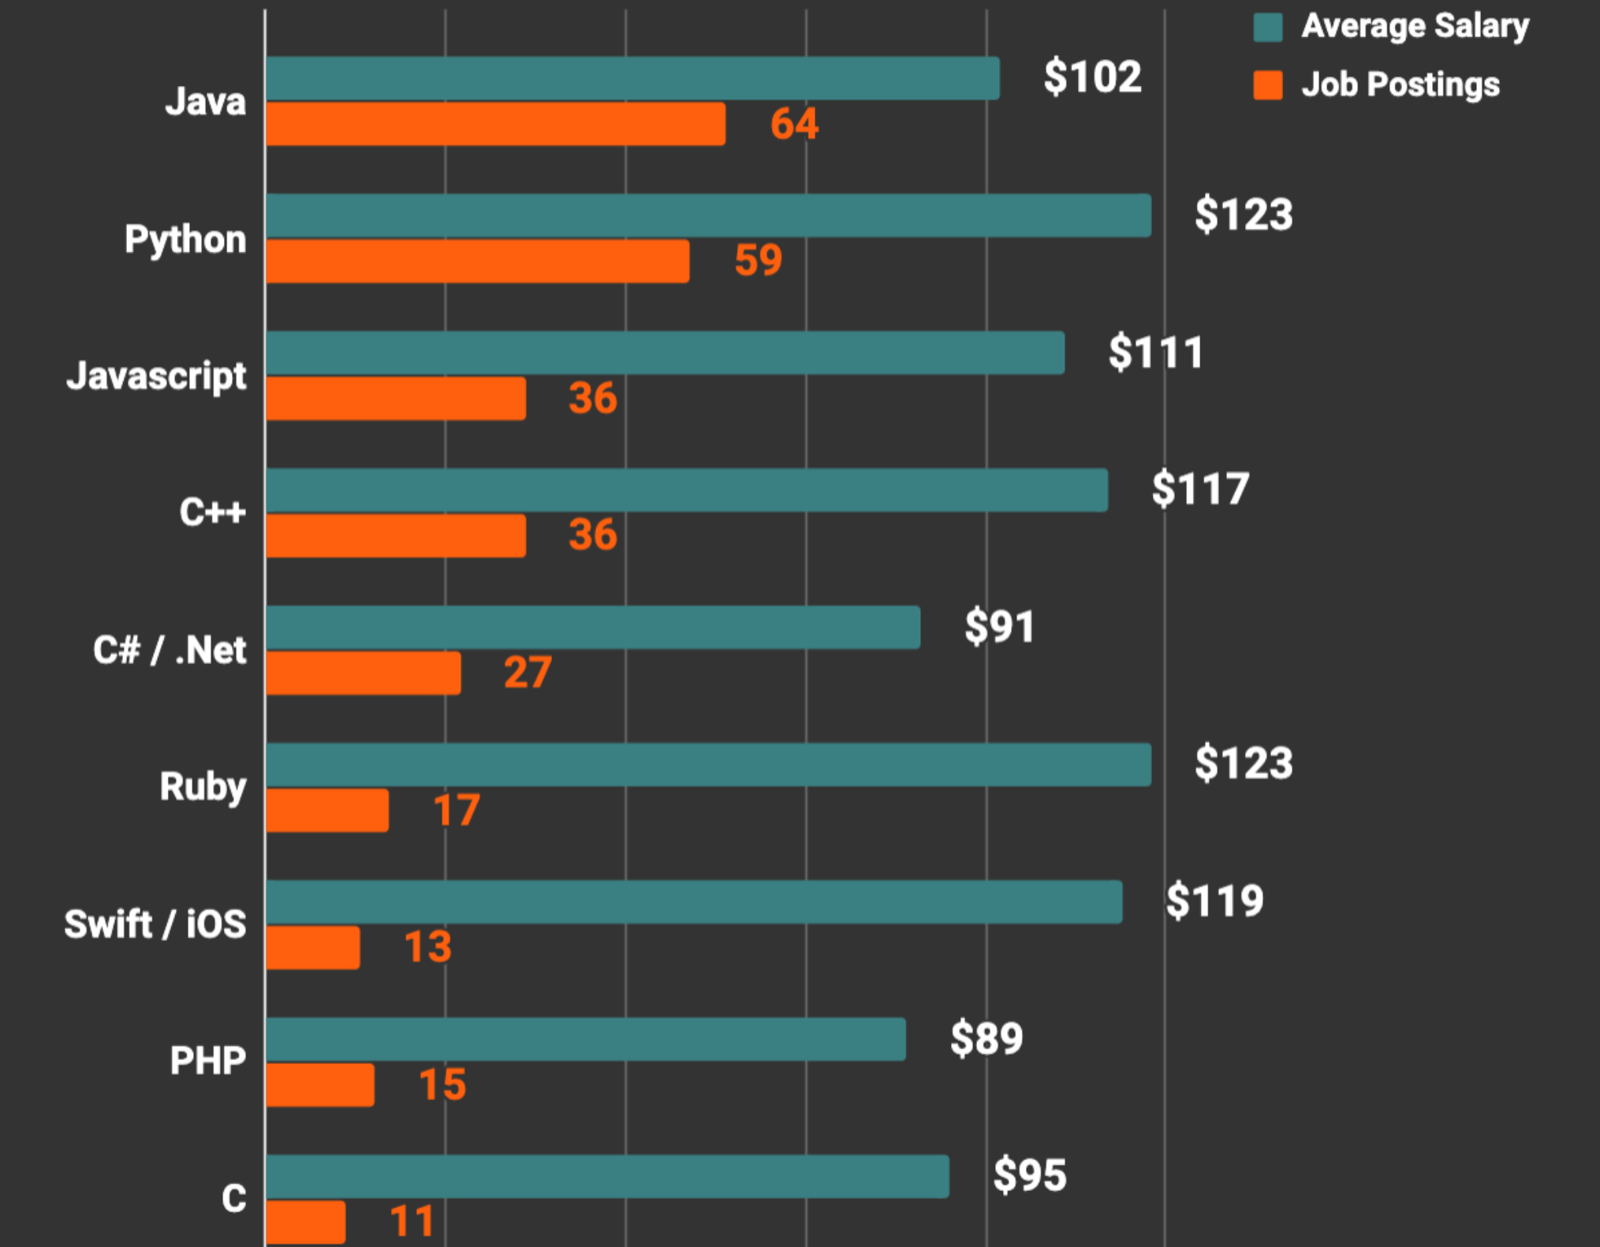
Top Programming Language in 2019
Codeplatoon.org

Slide 12

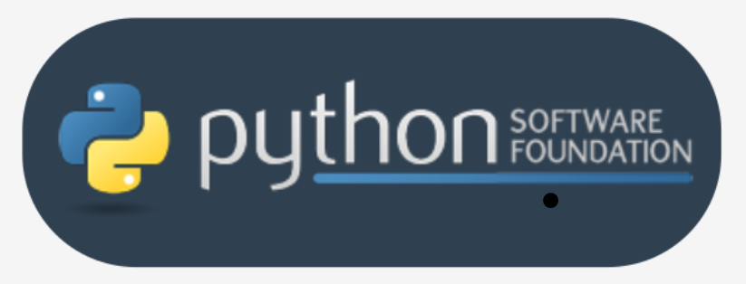
Different Versions of Python
In addition to Python 2 and Python 3, there is more than one version of each.
There are Pythons which are maintained by the the PSF (Python Software Foundation), a community that aims to develop, improve, expand, and popularize Python and its environment. Guido von Rossum is a president of it. They are also considered to be reference Pythons, as any other implementation of the language should follow all standards established by the PSF.
All Pythons coming from the PSF are written in the "C" language. This is why the PSF implementation is often referred to as CPython.

Slide 13
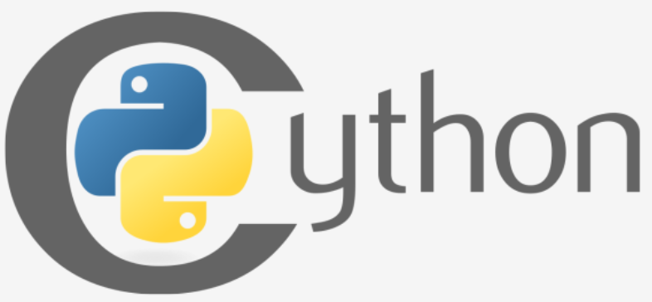
Cython
Cython is one of a possible number of solutions to the most painful of Python's trait - the lack of efficiency. Large and complex mathematical calculations may be easily coded in Python (much easier than in "C" or any other traditional language), but the resulting code's execution may be extremely time-consuming.

Slide 14
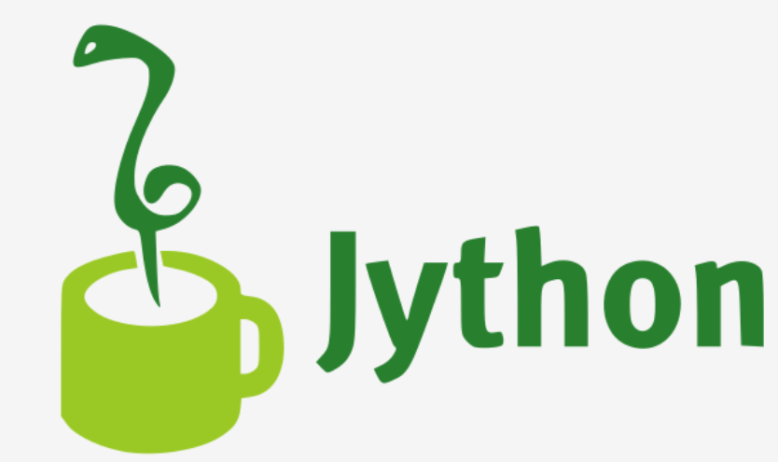
Jython
Jython can communicate with Java infrastructure more efficiently.
It follows Python 2 standards.

Slide 15
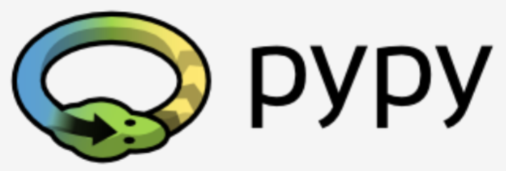
PyPy and RPython
PyPy: Python within the Python. A Python environment written in Python-like language named RPython (Restricted Python). It is actually a subset of Python.

